Slide 1
Business Forecasting Project
5-year forecast for US monthly birth data
Fall 2024
Anh Nhat Minh Nguyen

Slide 2
Index
Introduction: US Birth data
Exploratory Data Analysis
Forecasting question & evaluation criteria
Forecasting models
Summary

Slide 3
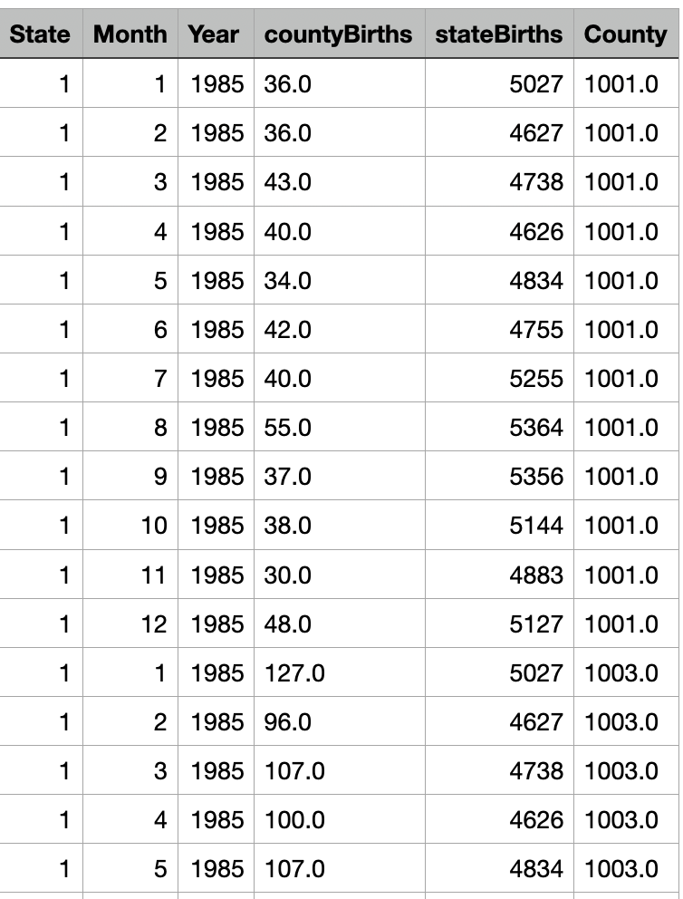
1. Introduction: US Birth data
Data source: Kaggle.com
Collecting agent: National Bureau for Economic Research and the National Center for Health Statistics. Birth data is provided by the National Center for Health Statistics (NCHS) and state vital records offices
Raw data: the number of monthly births in each US county in each month from 1985 - 2015
Aggregated data: the number of : the number of monthly births in the US in each month from 1985 – 2015
Data size: 372 records
Programming language: R

Slide 4
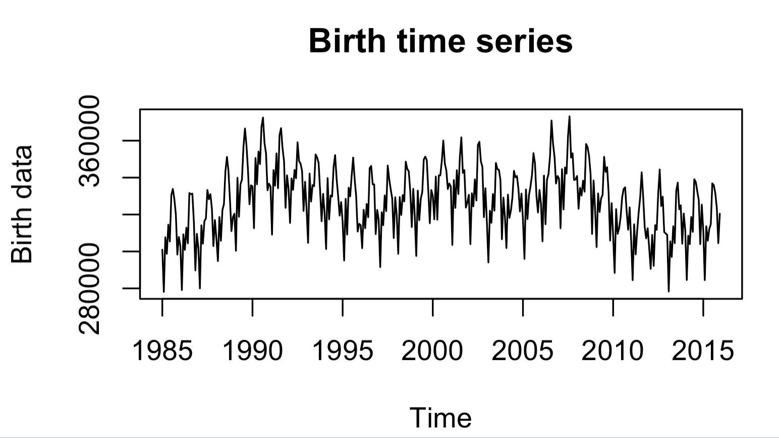
2. Exploratory Data Analysis
The time series shows that the birth data has a seasonal pattern and there is an underlying fluctuating trend.

Slide 5
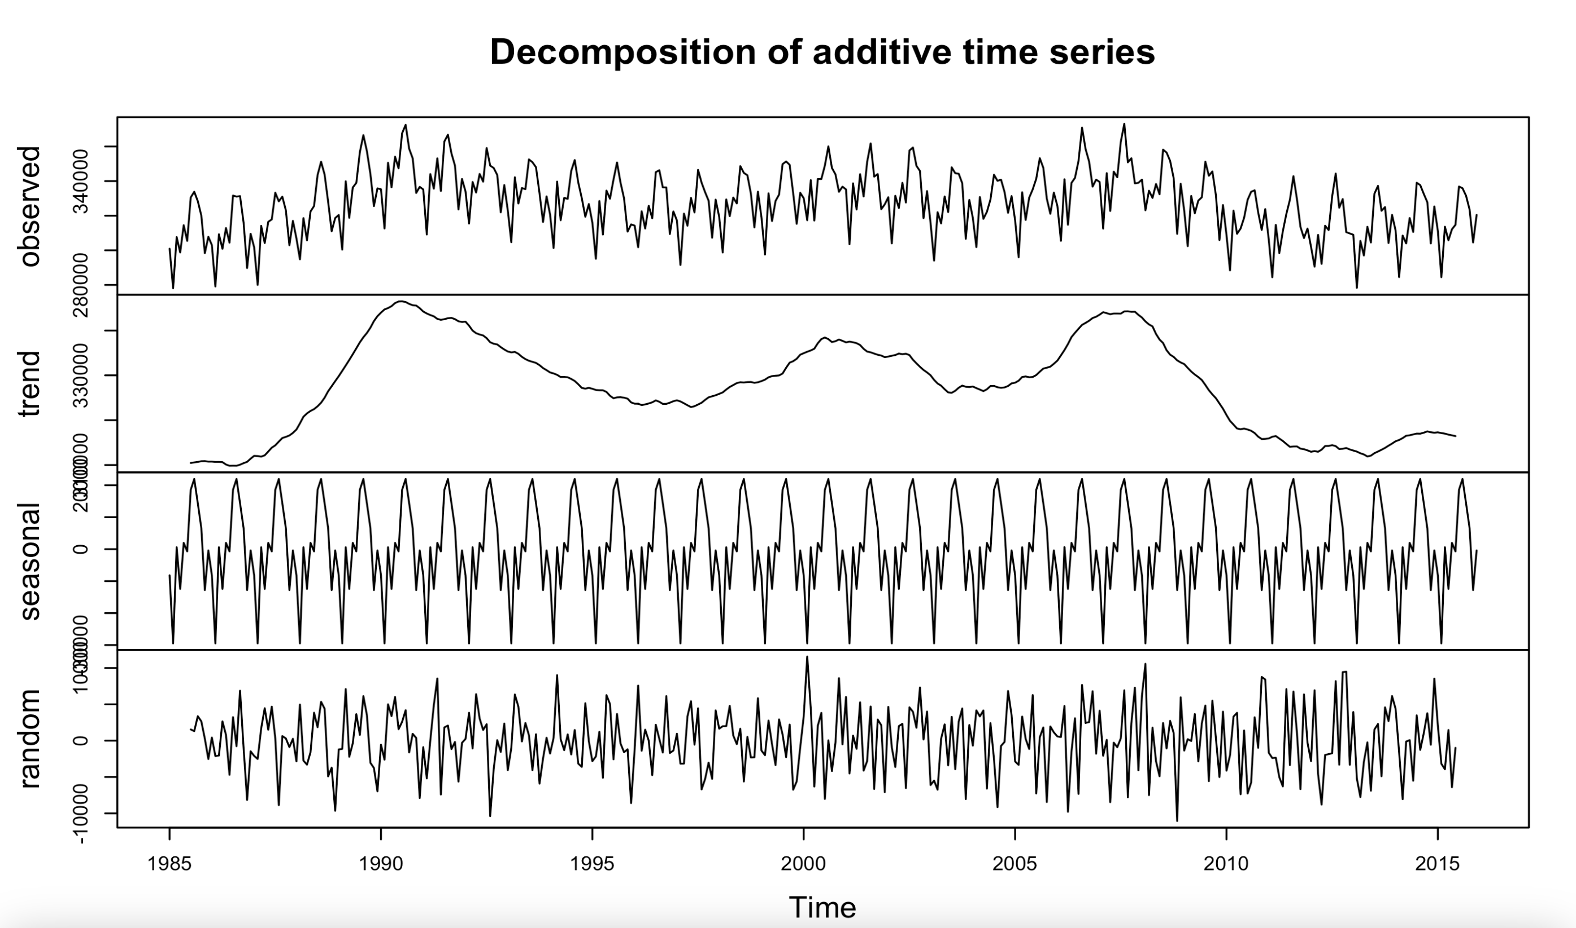
2. Exploratory Data Analysis
Type: additive
Trend: the time series has an underlying fluctuating trend
Seasonality: Months with the most births: July & August, months with the least births: February & November

Slide 6
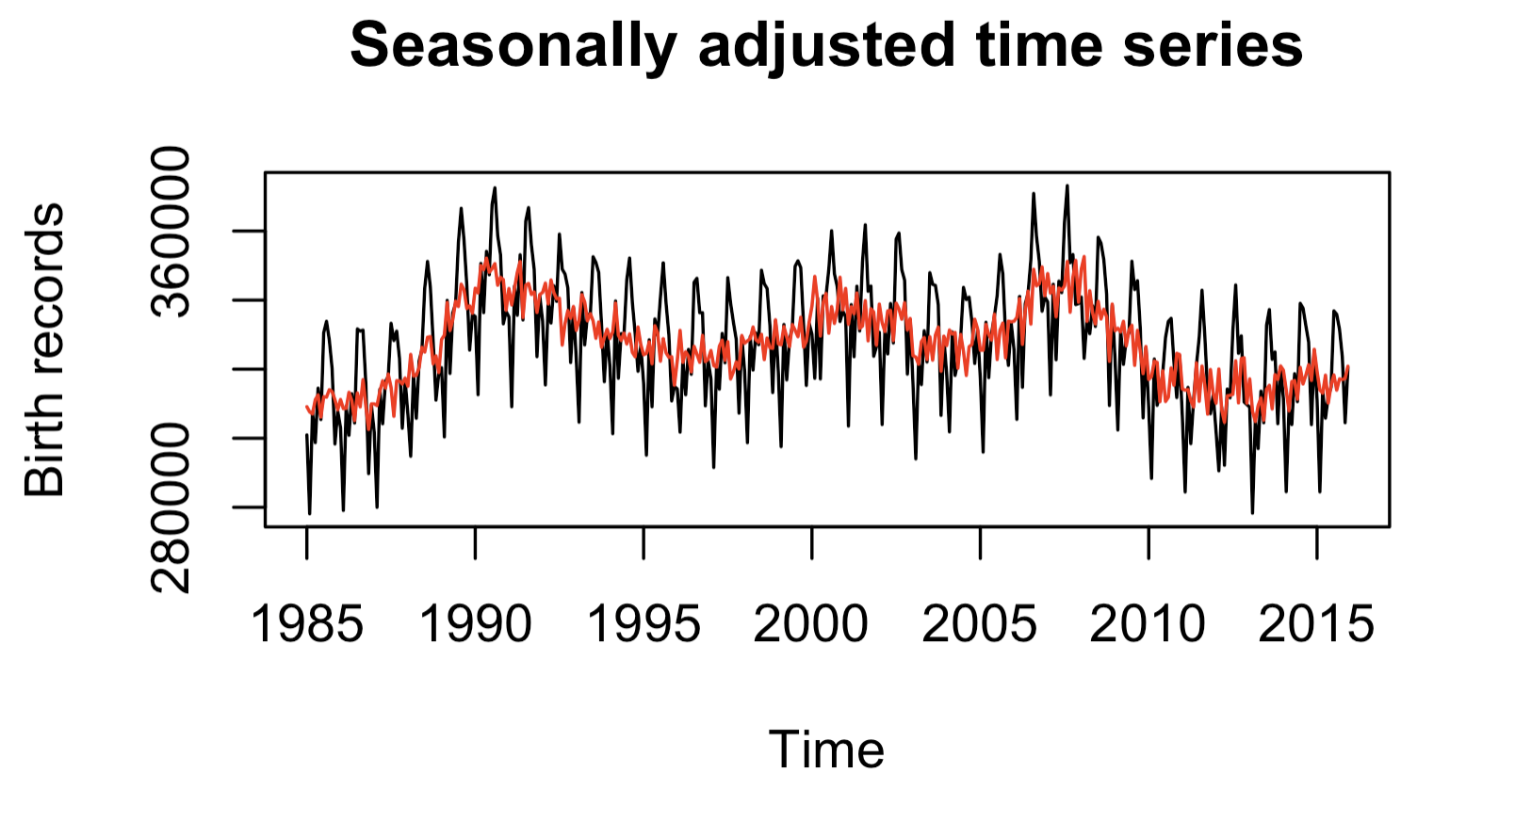
2. Exploratory Data Analysis
The time series is heavily affected by its seasonal component.

Slide 7
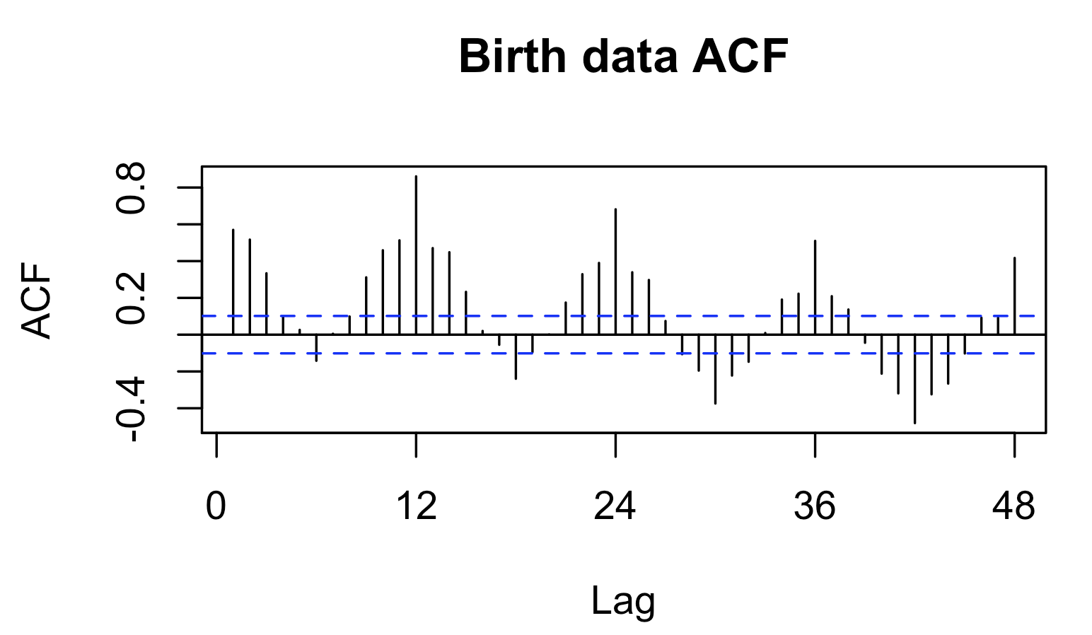
2. Exploratory Data Analysis
A high correlation is observed every 12 lags.
Clustered and repetitive ACF values: birth records in a month can be affected by adjacent previous and following months

Slide 8
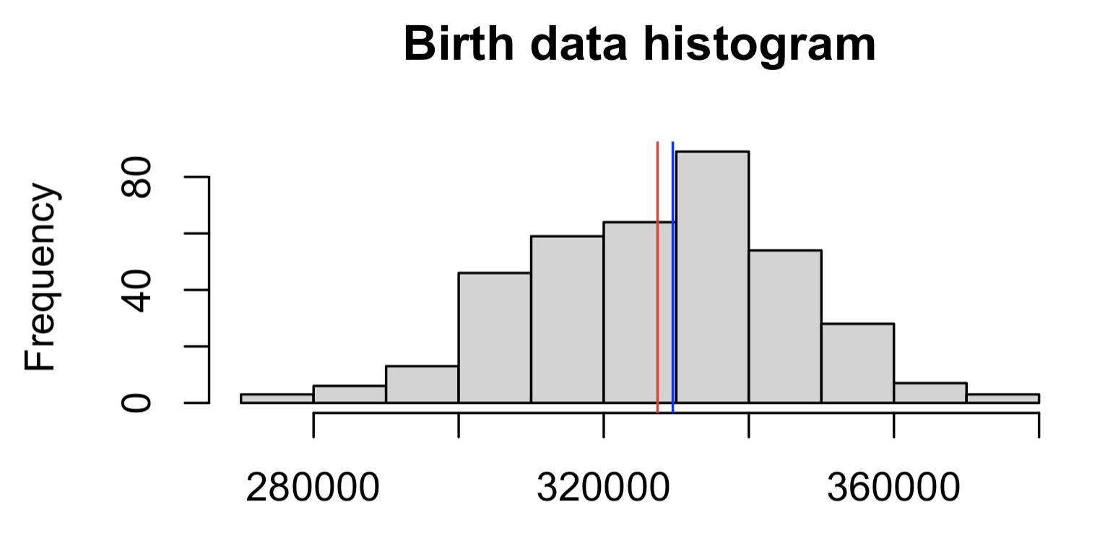
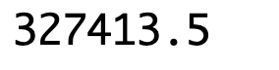
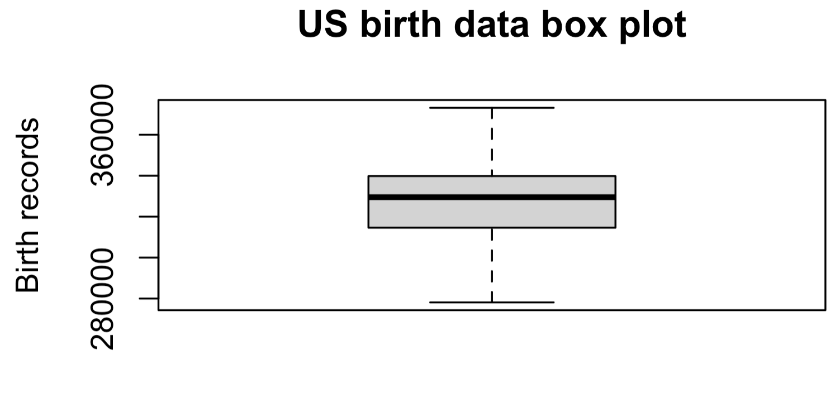
2. Exploratory Data Analysis
Median
Key data summary: Min-Q1-Median-Q3-Max
Mean
Mean
On average, the US has around 330,000 babies each year. The annual birth rate mostly ranges from 310,000 to 370,000.
There are no outliers detected.

Slide 9
3. Forecasting question & evaluation criteria
The exploratory analysis suggests the time series has a seasonal and an underlying fluctuating trend.
The level shifts every 5 years.
Forecast question: What are the projected birth records for the following 5 years?
Application: The forecast can be used by the US government to rectify their policies in family support, maternal healthcare, education, etc.
Forecast models: (1) Naïve (2) Mean (3) Simple Moving Average (MA) (4) Simple Exponential Smoothing (SES) (5) Holt-Winters (6) ARIMA (7) Decomposition (8) Simple Linear Regression (SLR)
Evaluation criteria: (1) Mean Absolute Percentage Error (MAPE) (2) Residual validation. The estimated percentage deviation can help the US government plan their budget, resources, and facilities.
The entire dataset will be used for forecasting since the time series does not change its patterns between 1985 and 2015.

Slide 10
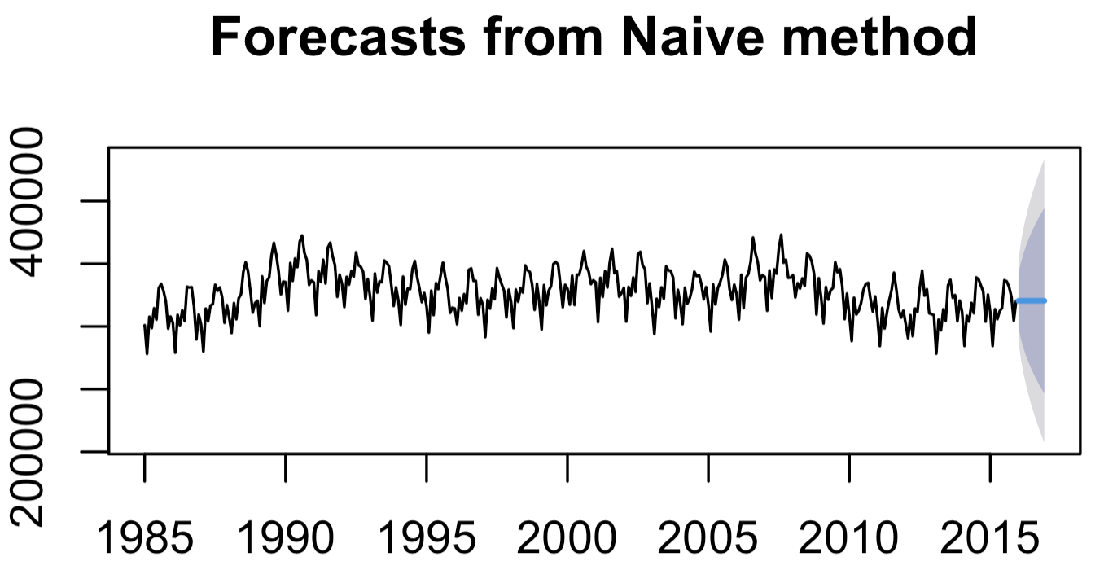
4. Forecasting models
Naïve model: forecasts
The value for the last period: December 2015, will be used as future forecasts.

Slide 11
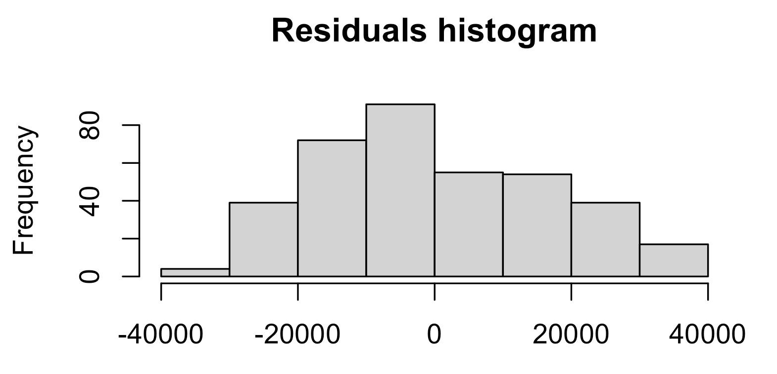
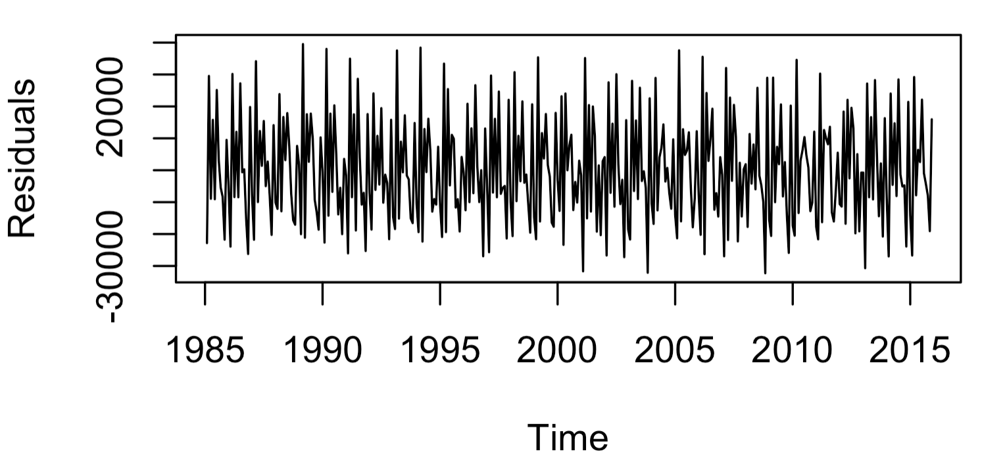
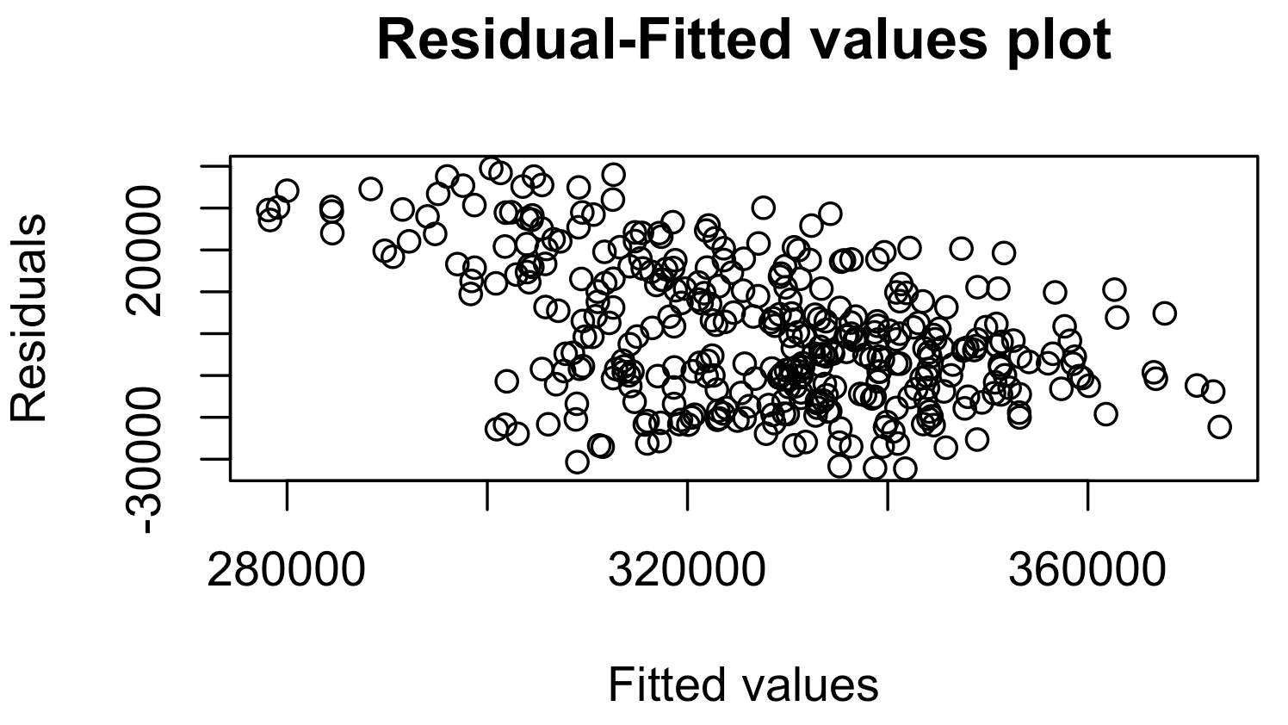
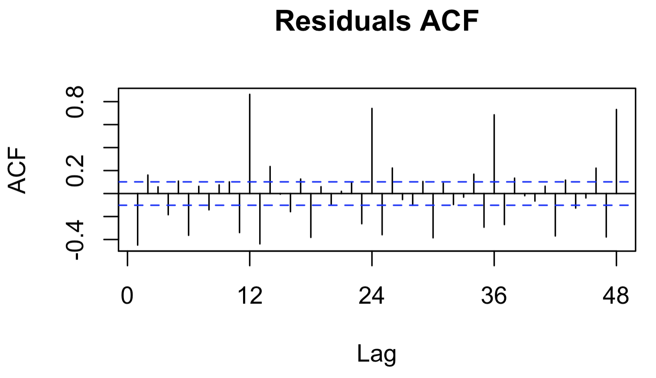
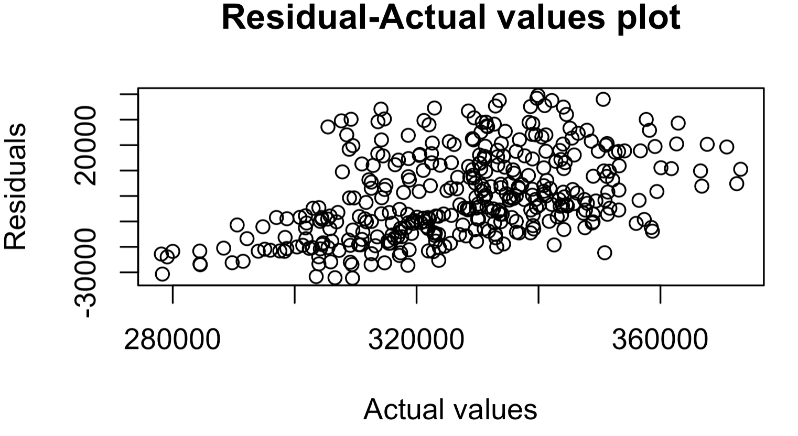
4. Forecasting models
The naïve model cannot capture the seasonal component of the time series.
Naïve model: residual analysis
Errors are higher for larger records
Seasonal peaks

Slide 12
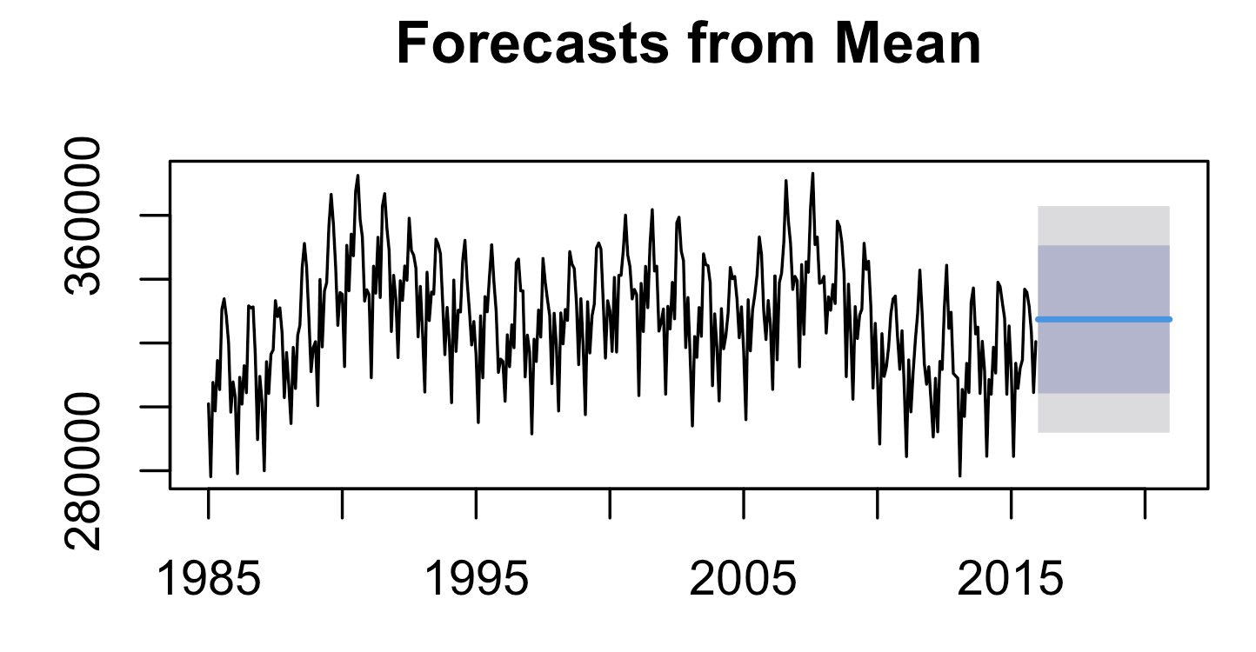
4. Forecasting models
Mean model: forecasts
The mean birth records (327,413.5) will be used as future forecasts.

Slide 13
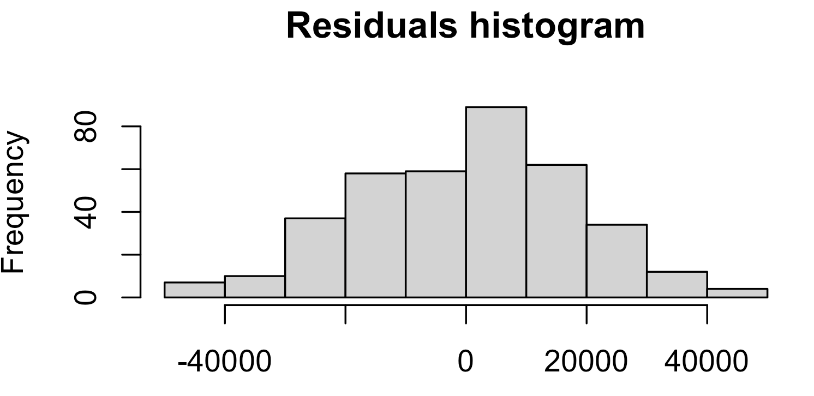
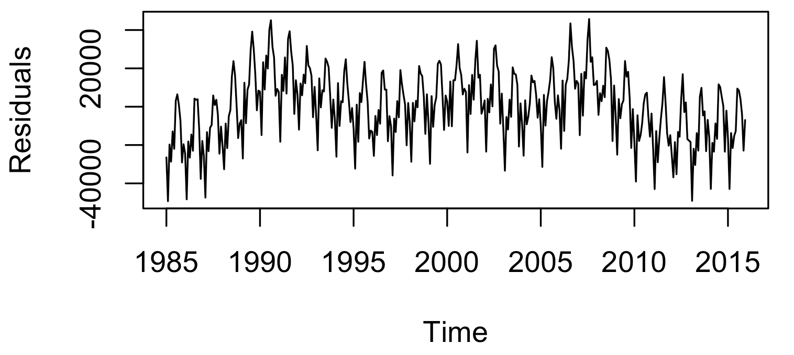
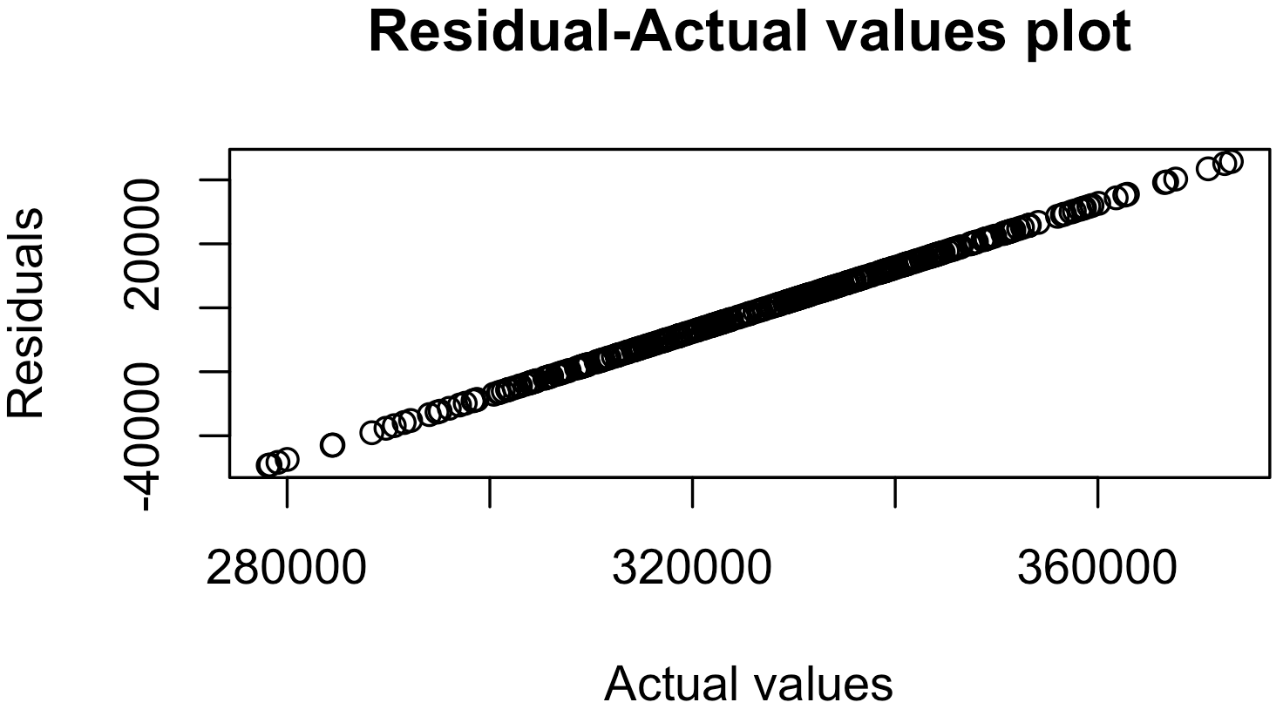
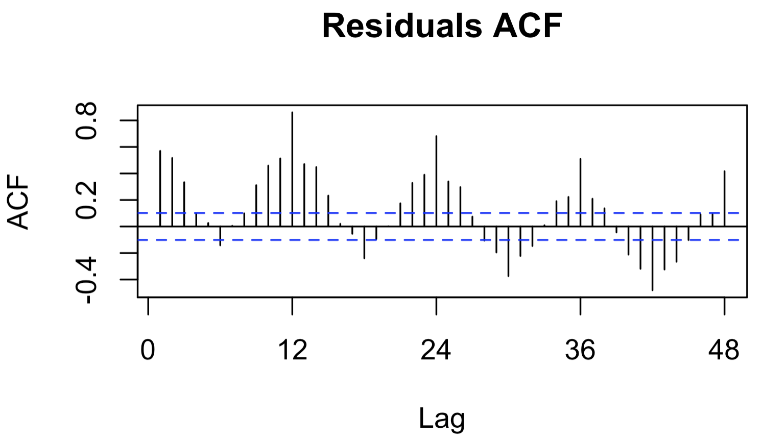
4. Forecasting models
The mean model, similarly, cannot capture most patterns of the time series.
Mean model: residual analysis
Both residuals and ACF plot are similar to those of the original time series

Slide 14
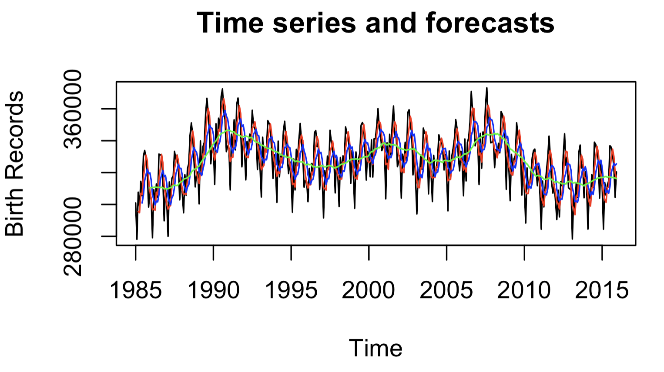
4. Forecasting models
MA(3), MA(6), and MA(12) models
Red: MA(3)
Blue: MA(6)
Green: MA(12)
The data is smoothed out and deviates more from the actual values as the forecasting windows increase.

Slide 15
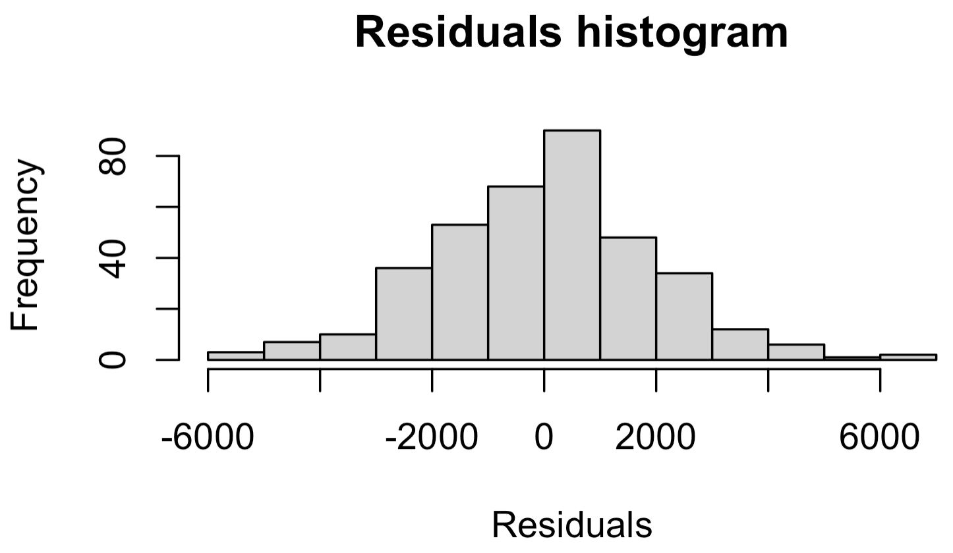
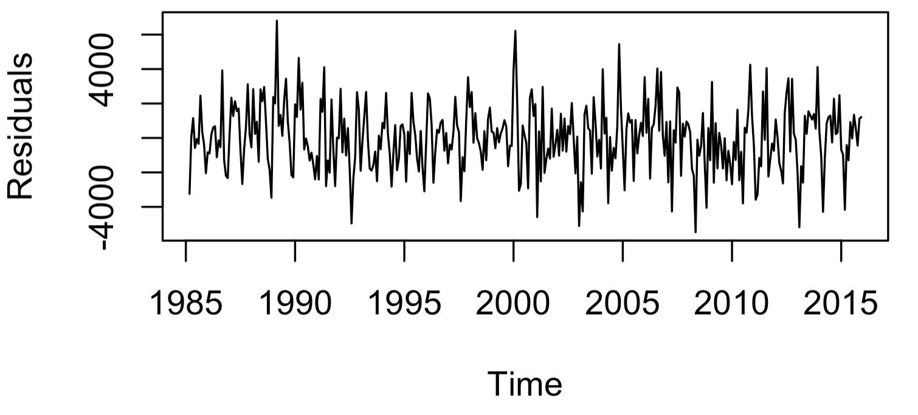
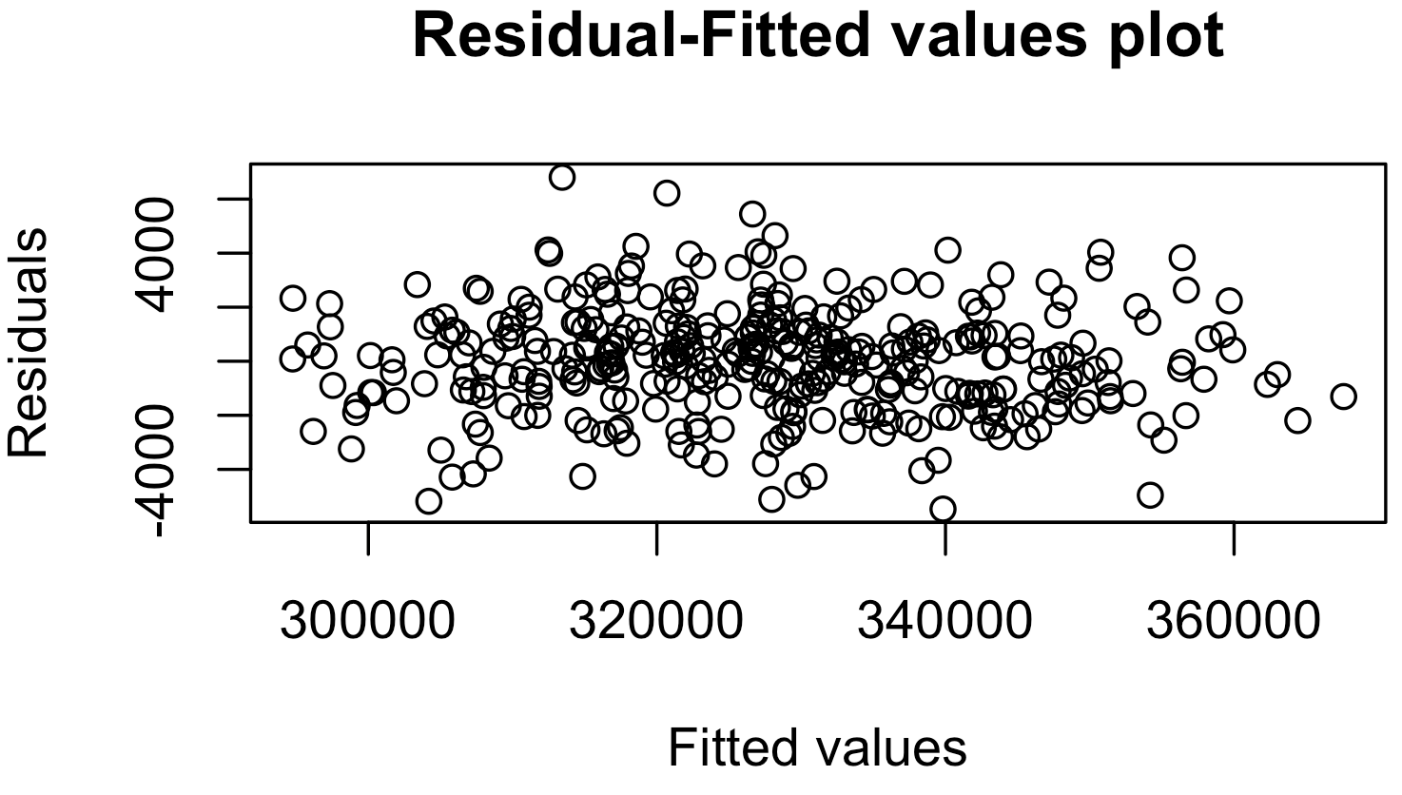
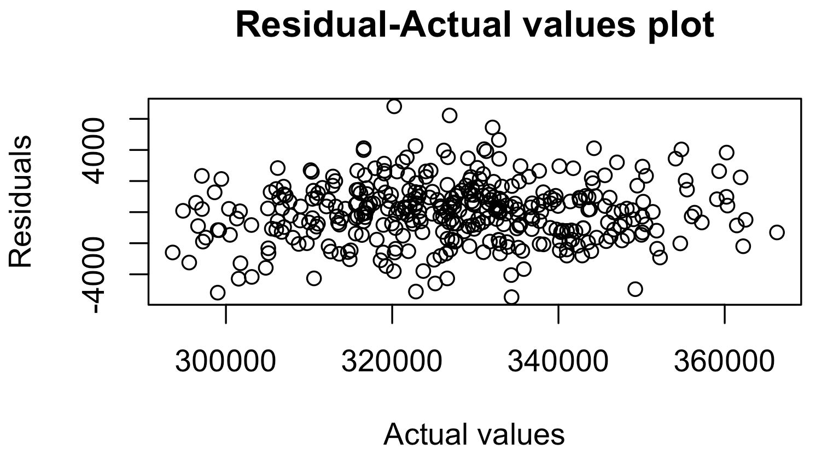
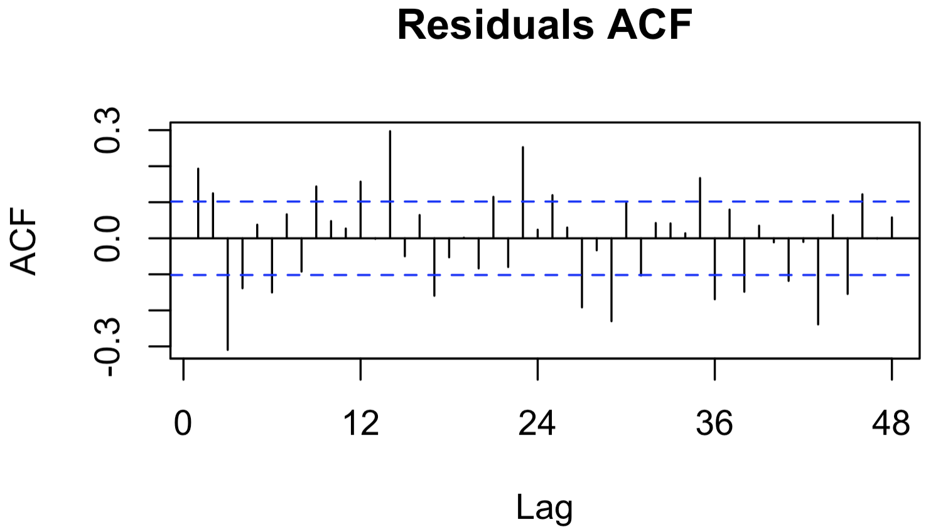
4. Forecasting models
The residuals for MA(3) appear to be more random, with no seasonality and trend detected. The error range is much smaller.
MA(3) model: residual analysis

Slide 16
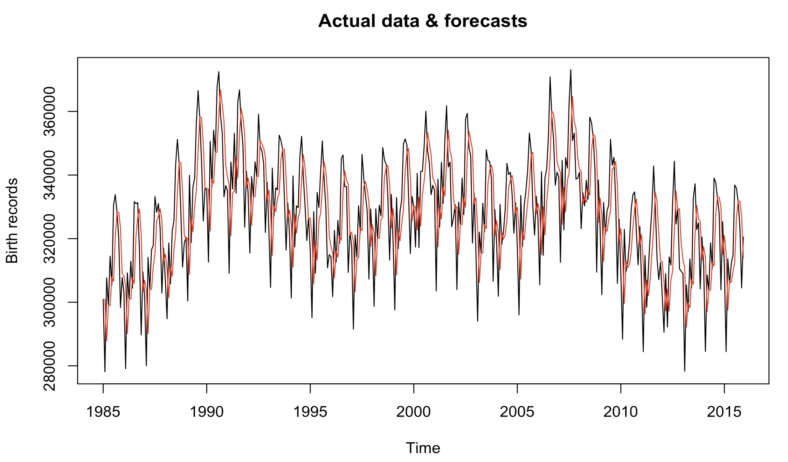
4. Forecasting models
Simple exponential smoothing (SES) model: forecasts
The plot suggests the SES model tends to underestimate high values and overestimate low values.

Slide 17
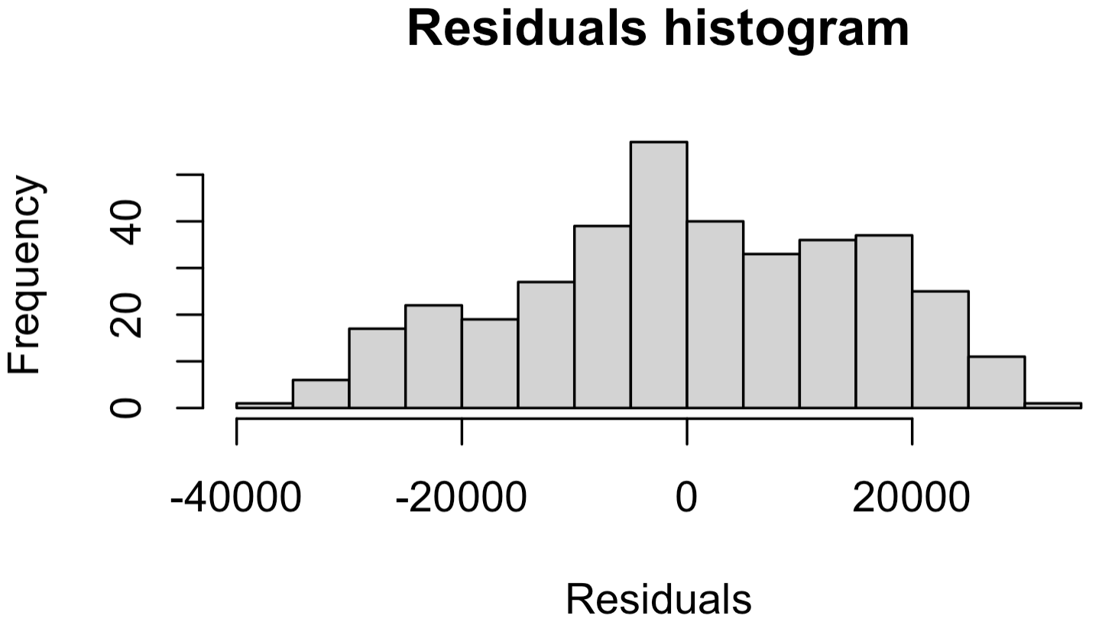
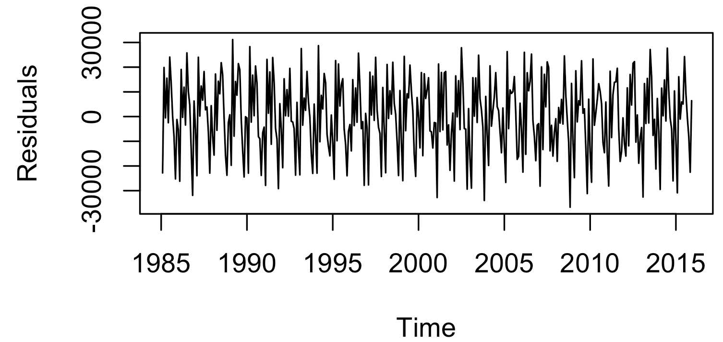
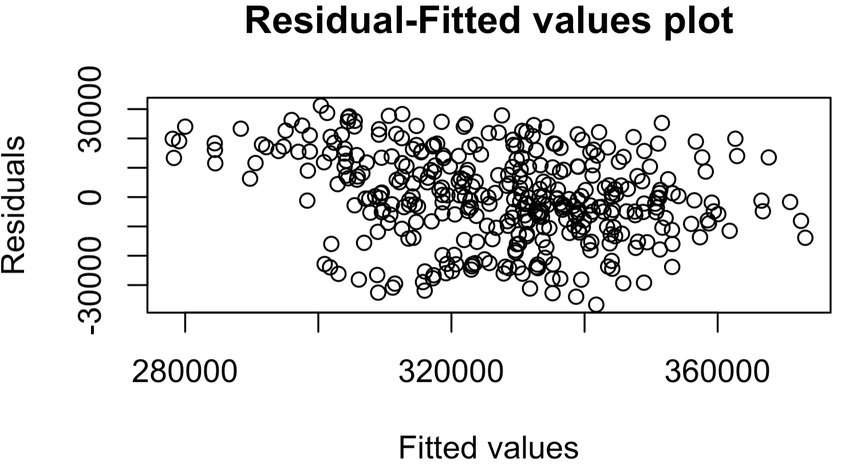
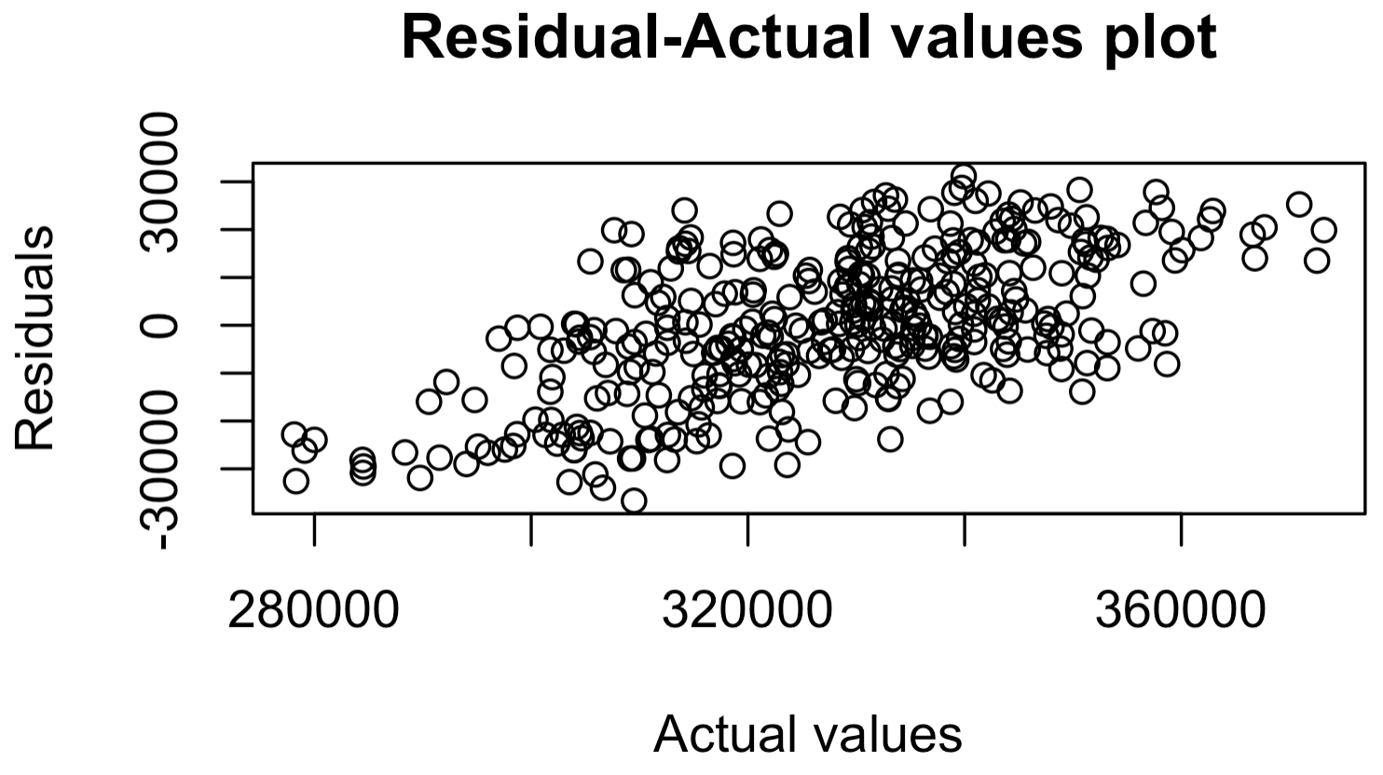
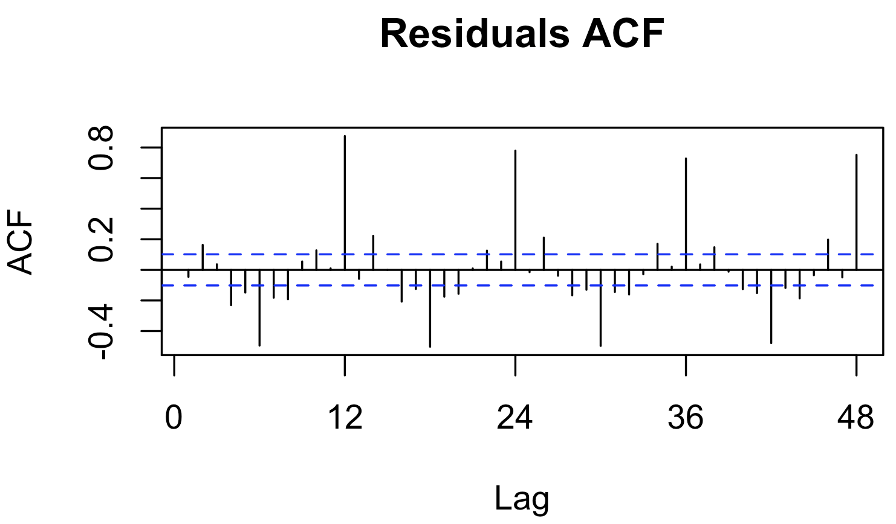
4. Forecasting models
The SES model cannot fully capture the seasonality component, as indicated by the ACF plot. Residuals are scattered and are less likely to be close to 0.
SES model: residual analysis

Slide 18
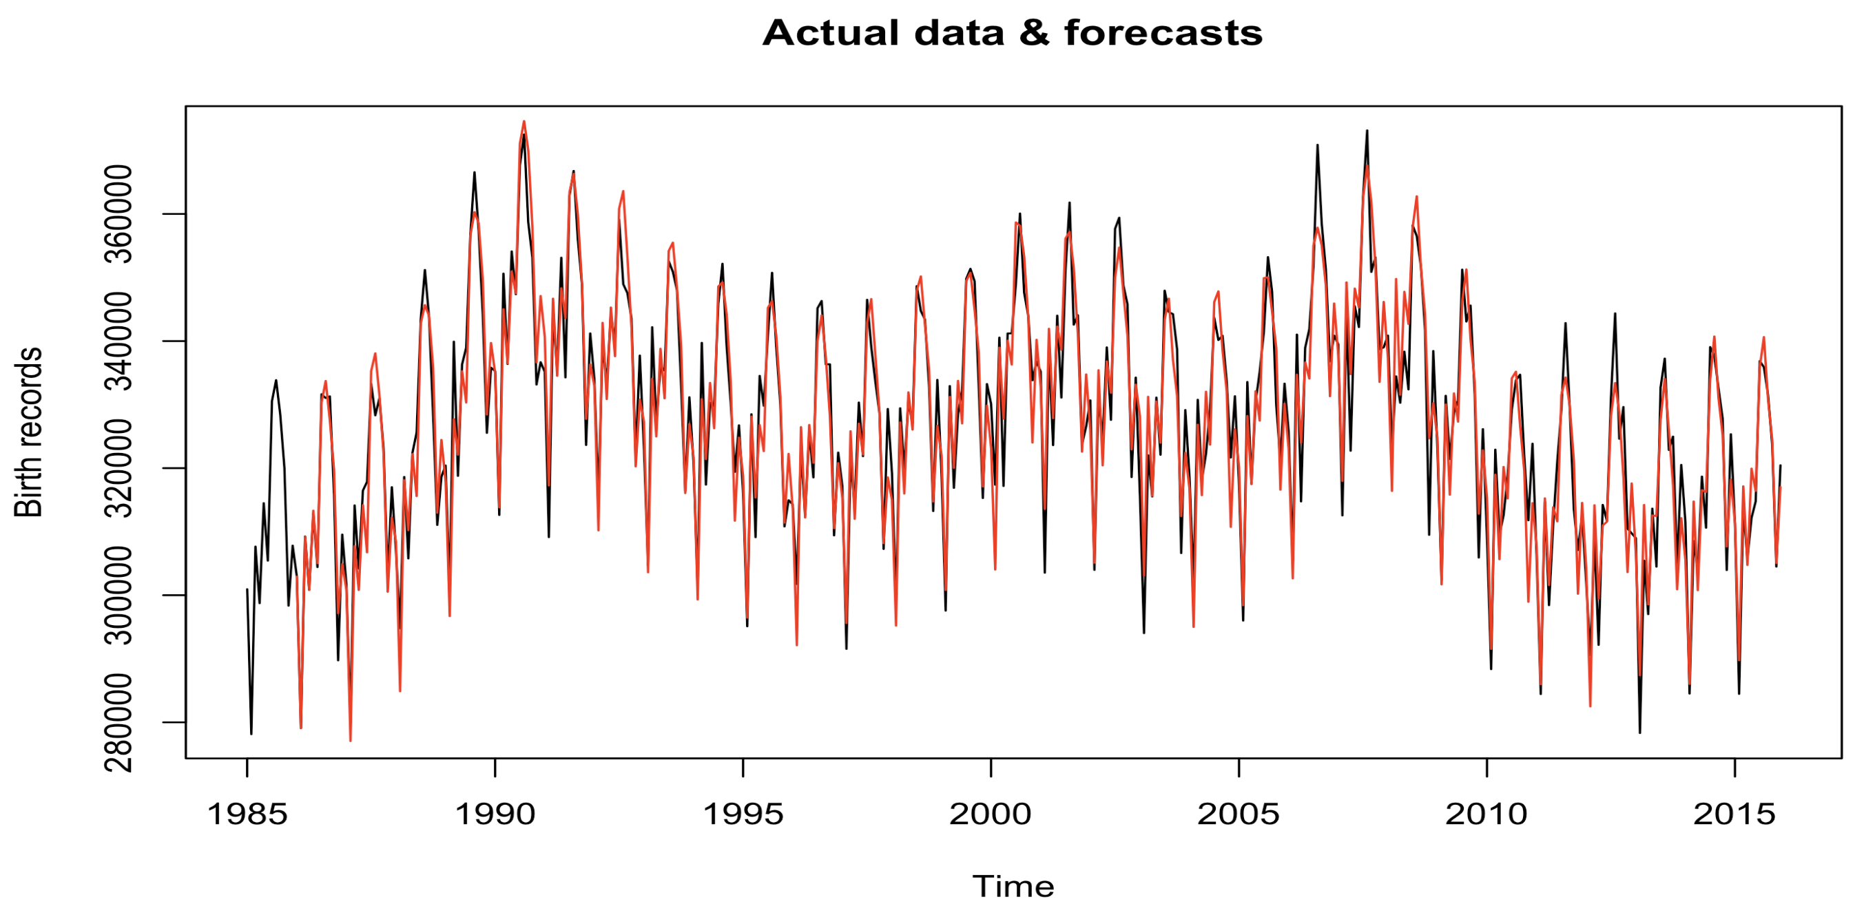
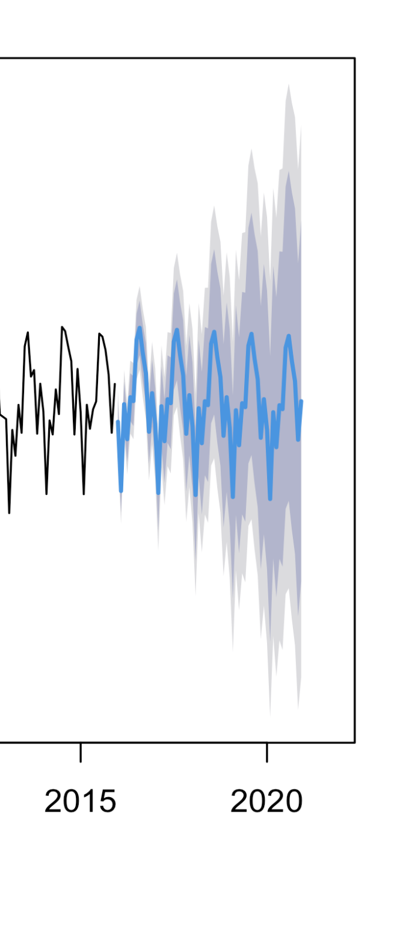
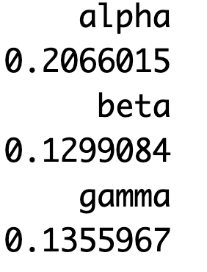
4. Forecasting models
The HW model improves its performance after the data point 1990.
Holt-Winters (HW) model: forecasts
A higher weight is given to the most recent point.
5-year forecast

Slide 19
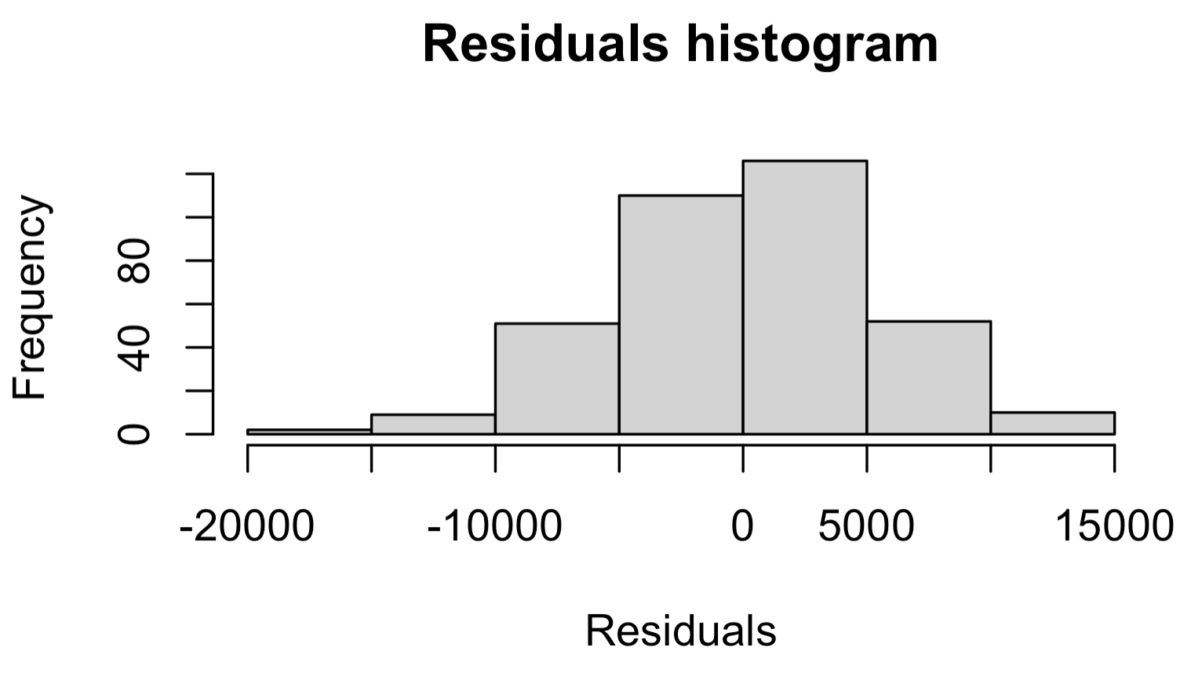
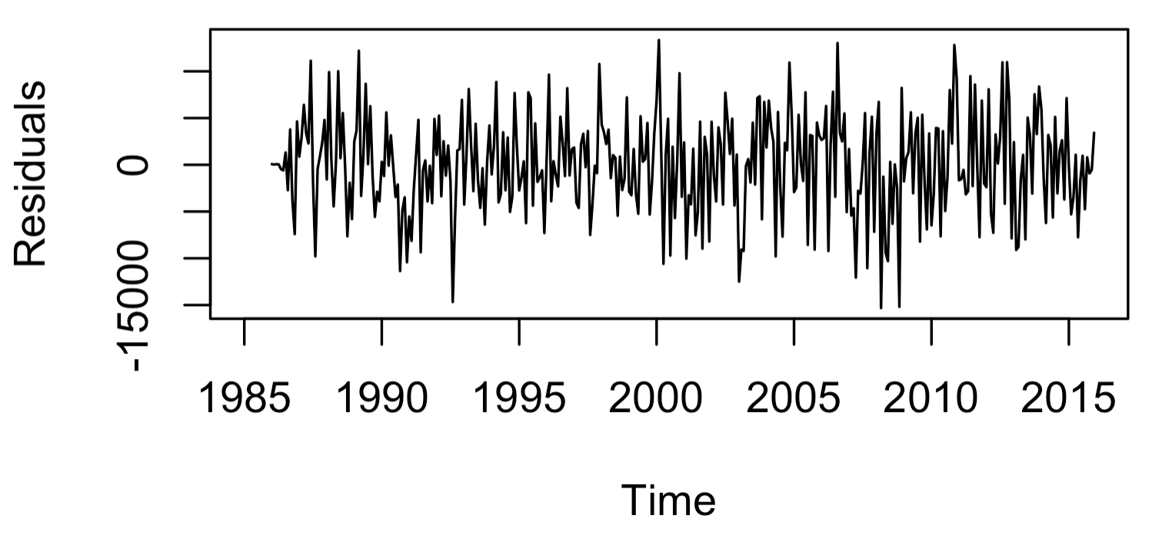
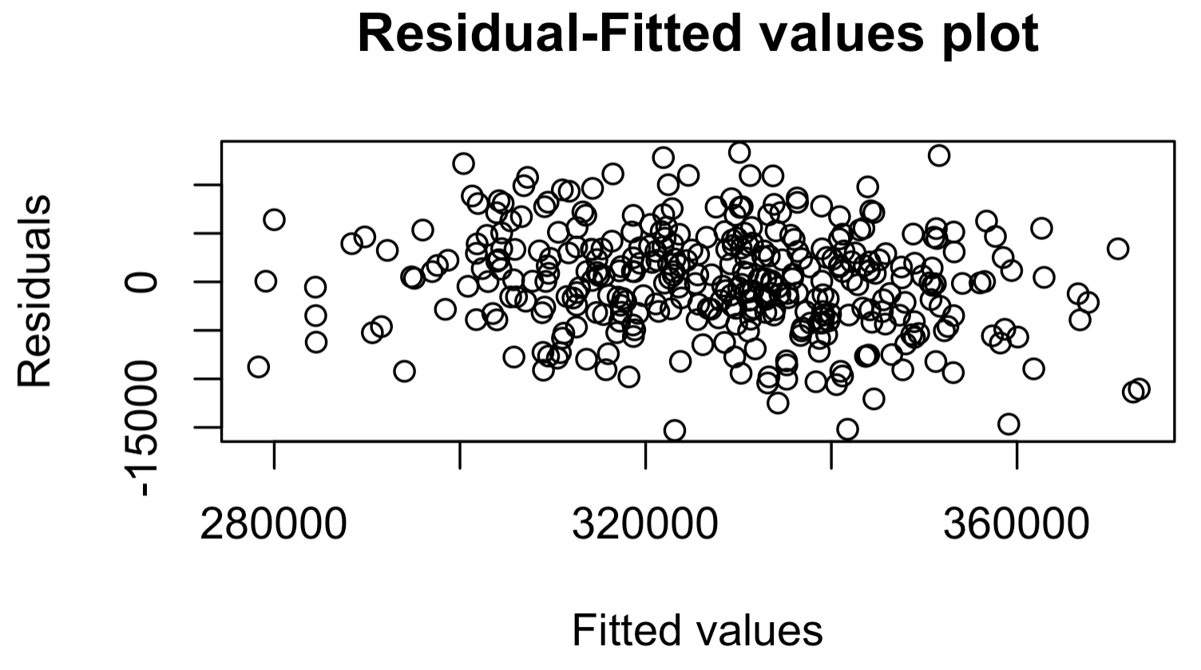
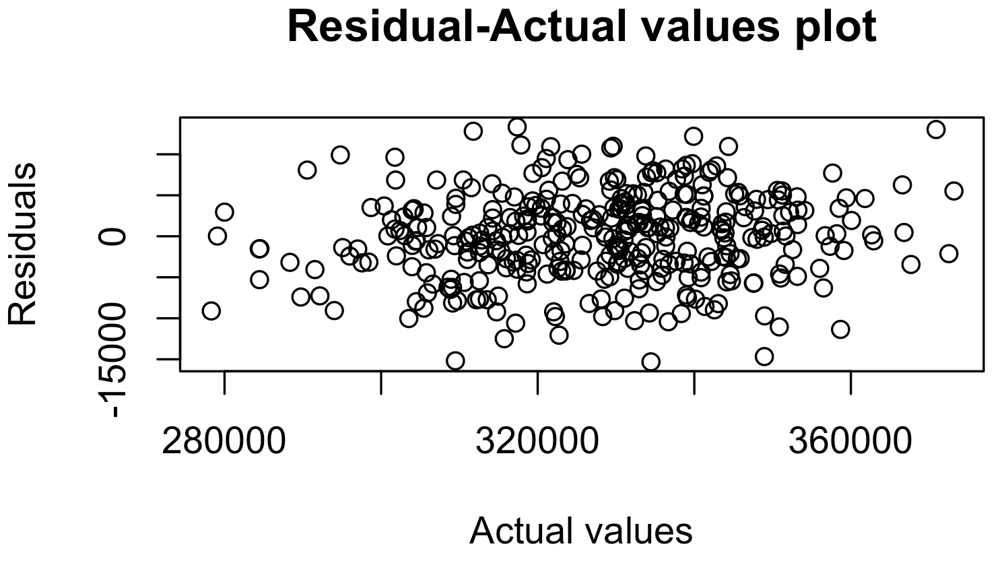
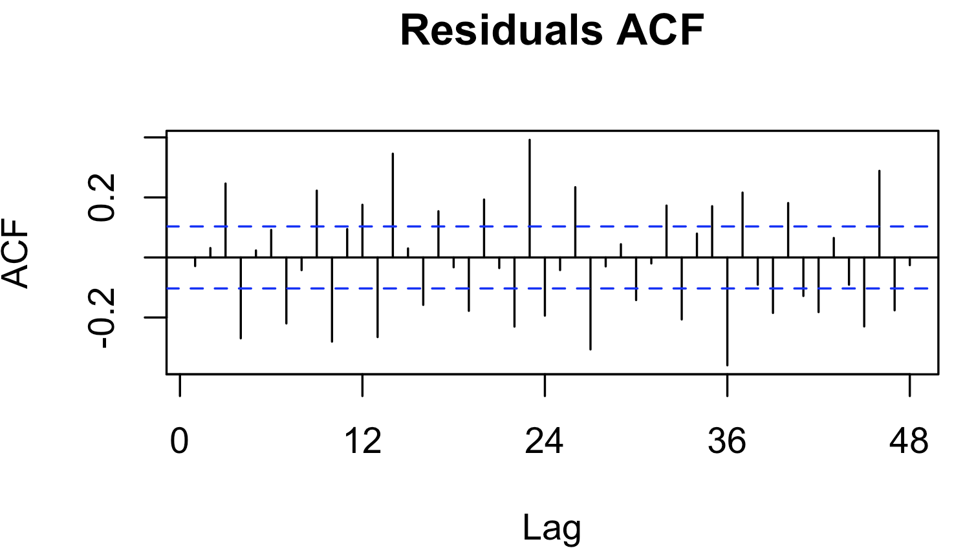
4. Forecasting models
The residuals for HW appear to be random, with no seasonality and trend detected.
HW model: residual analysis

Slide 20
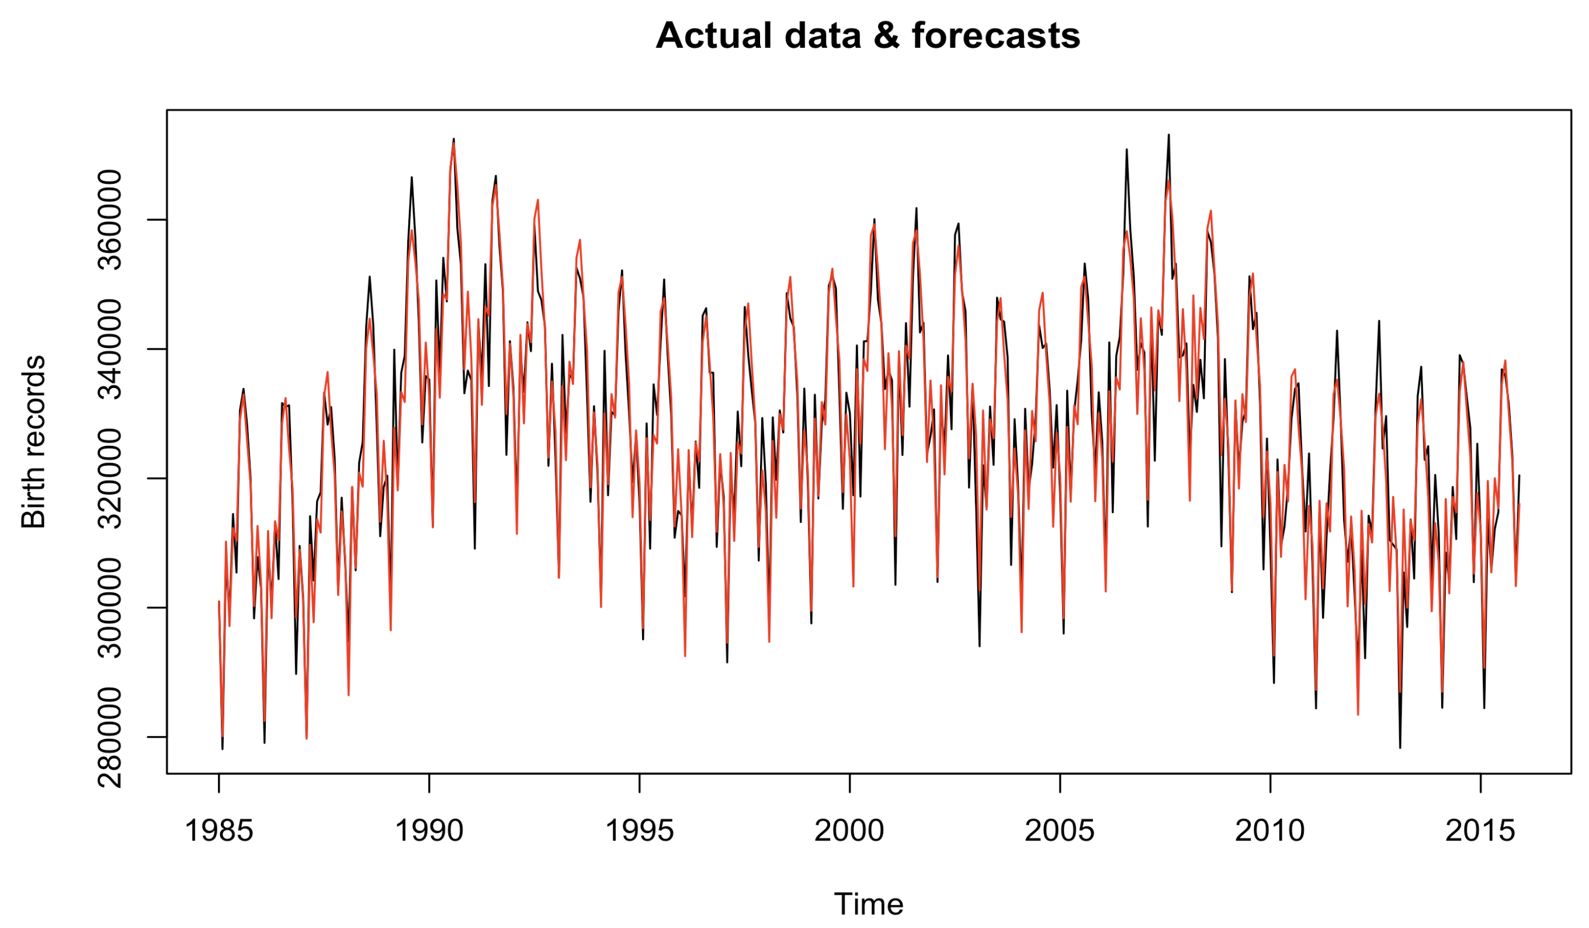
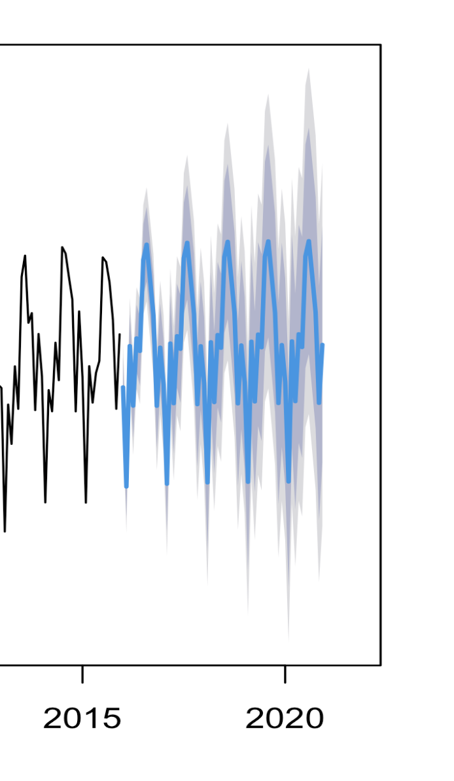
4. Forecasting models
Similar to HW, the decomposition model performs better as the time period moves further.
Decomposition model: forecasts

Slide 21
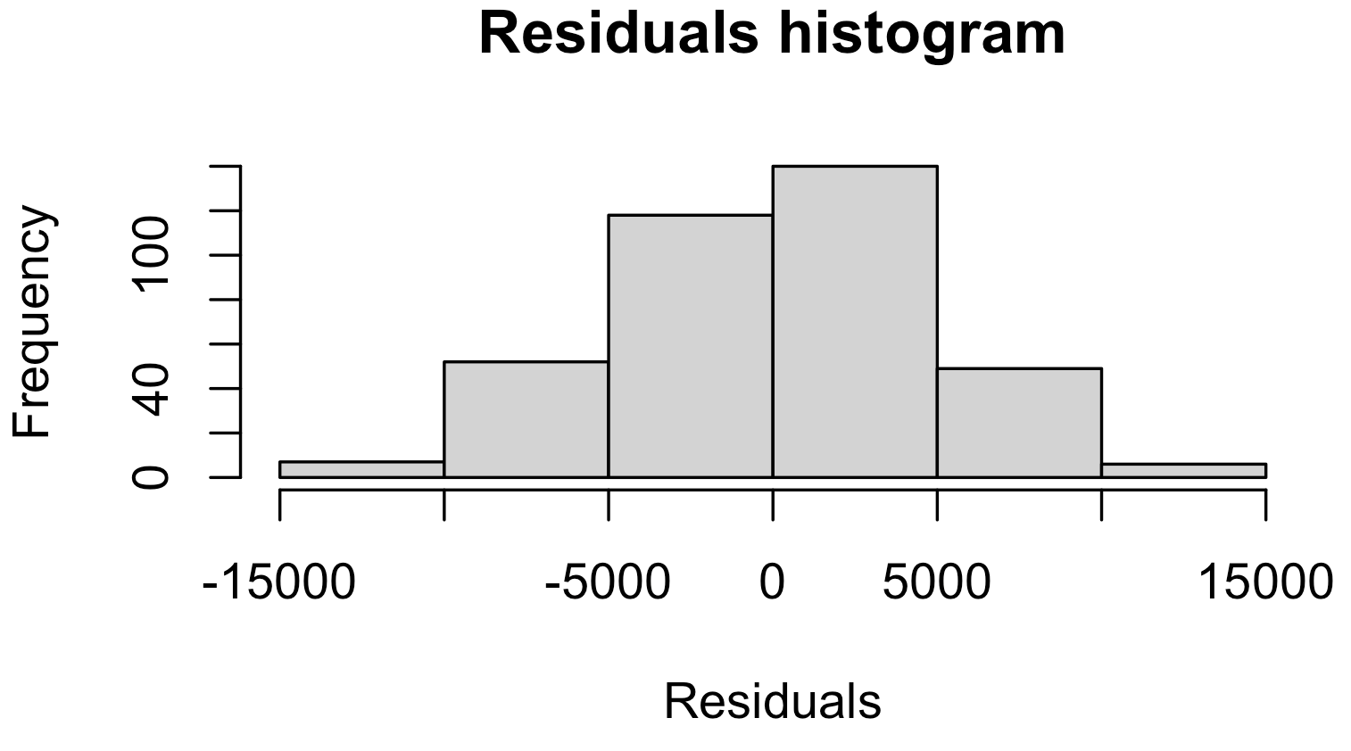
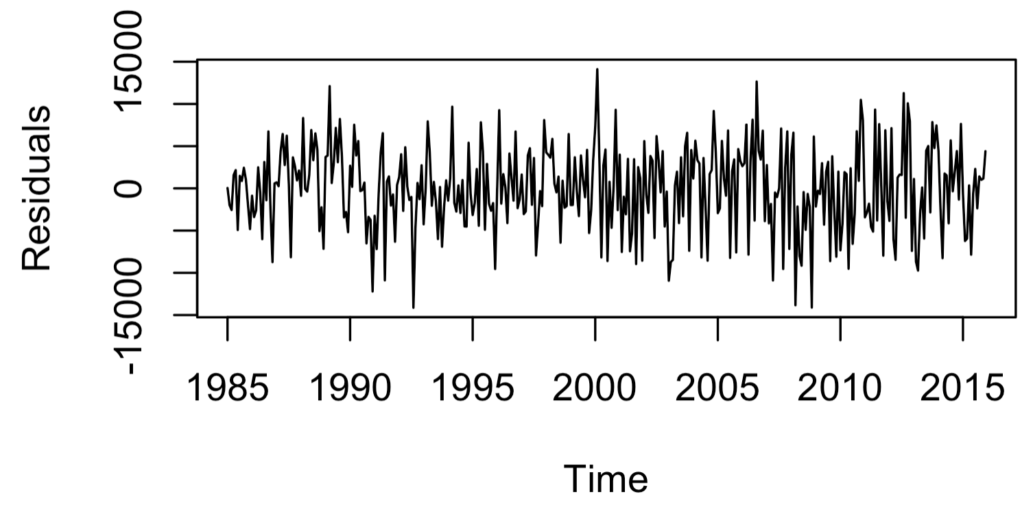
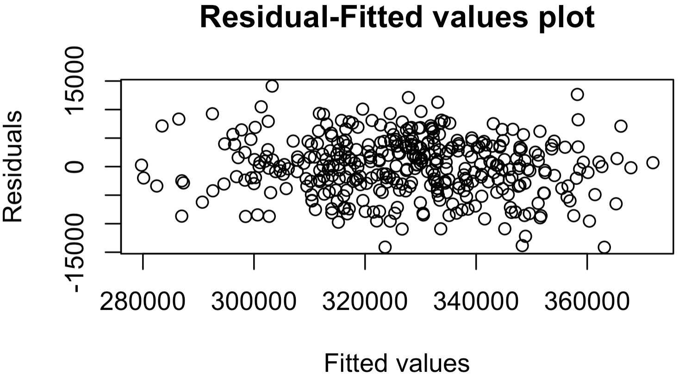
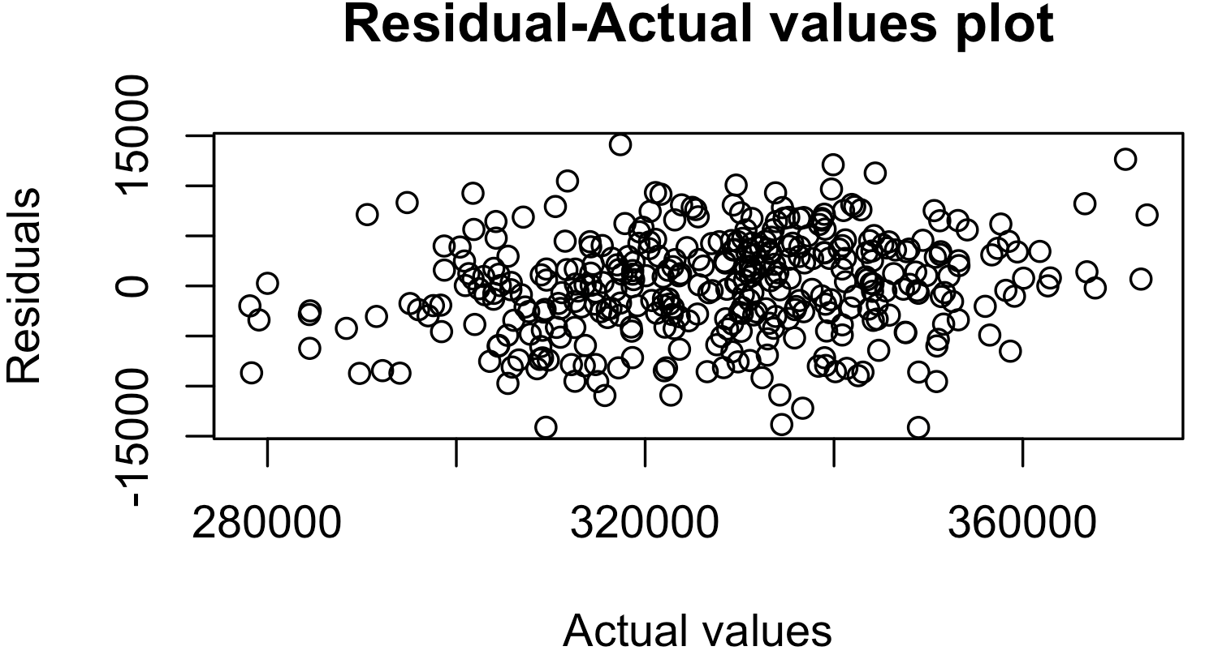
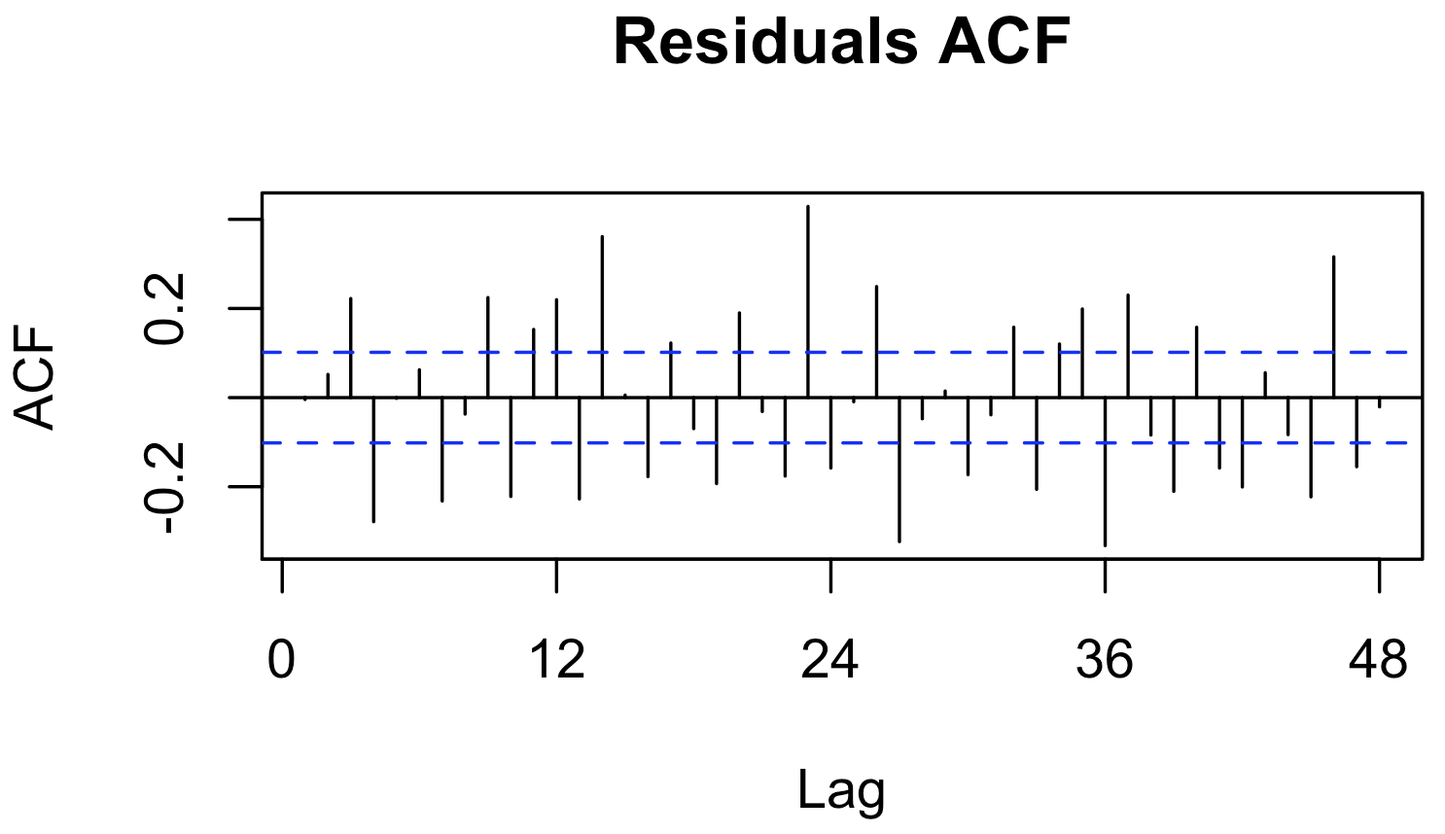
4. Forecasting models
The residuals for Decomposition model appear to be random, with no seasonality and trend detected.
Decomposition model: residual analysis

Slide 22

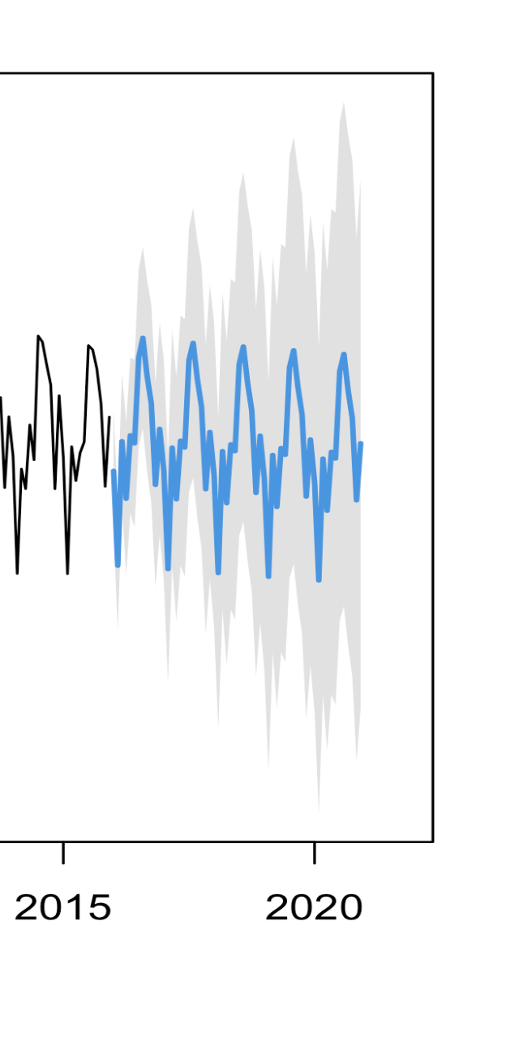
4. Forecasting models
ARIMA model: forecasts
Selected model: ARIMA(4,1,0)(0,1,1)[12]
Forecastsing results fit the actual data well.

Slide 23
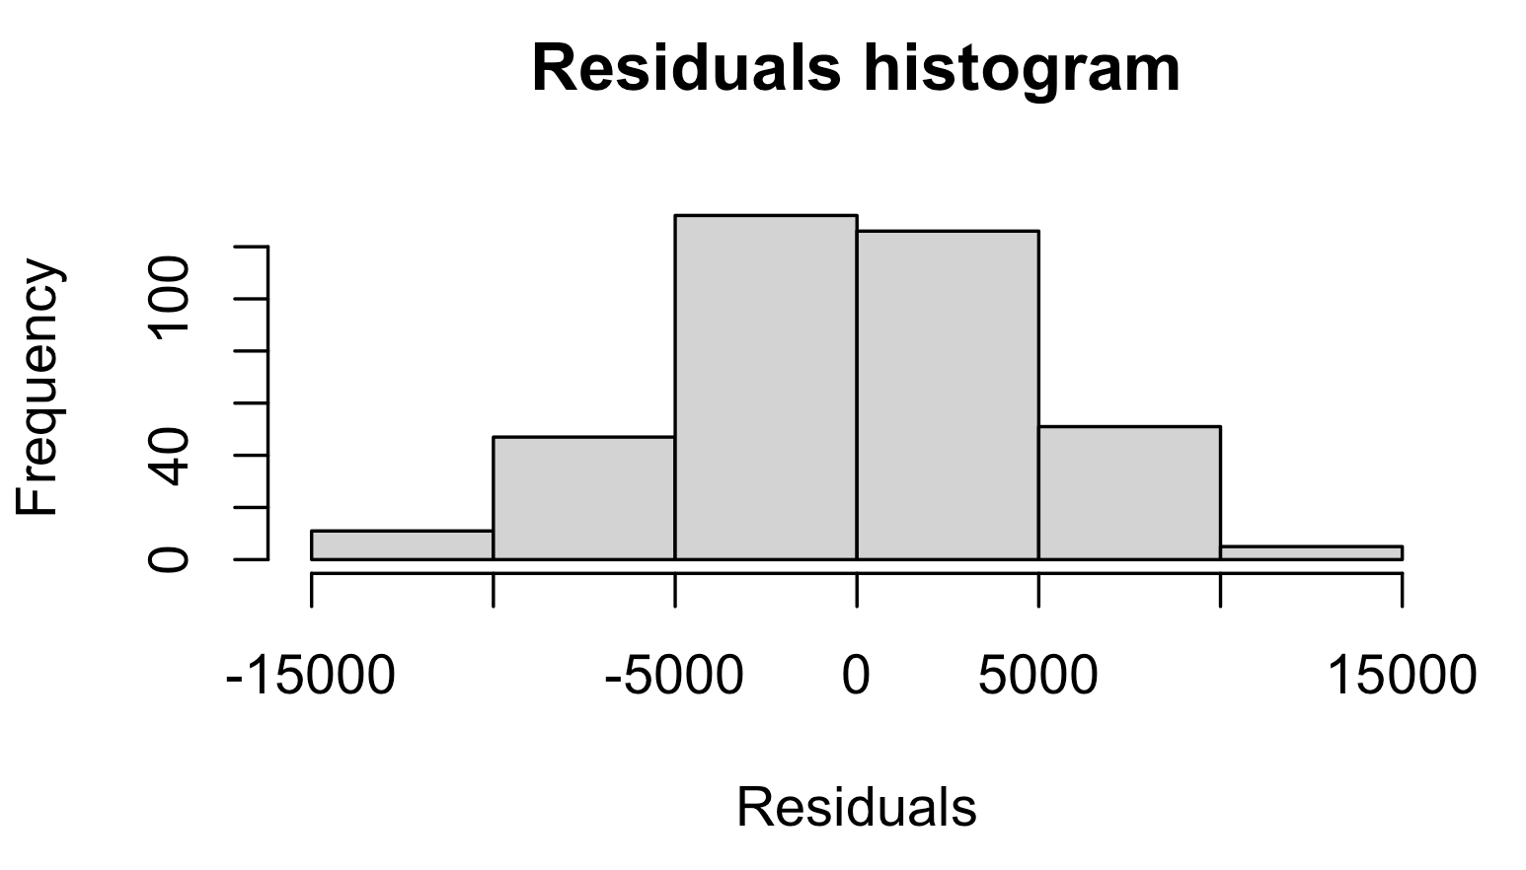
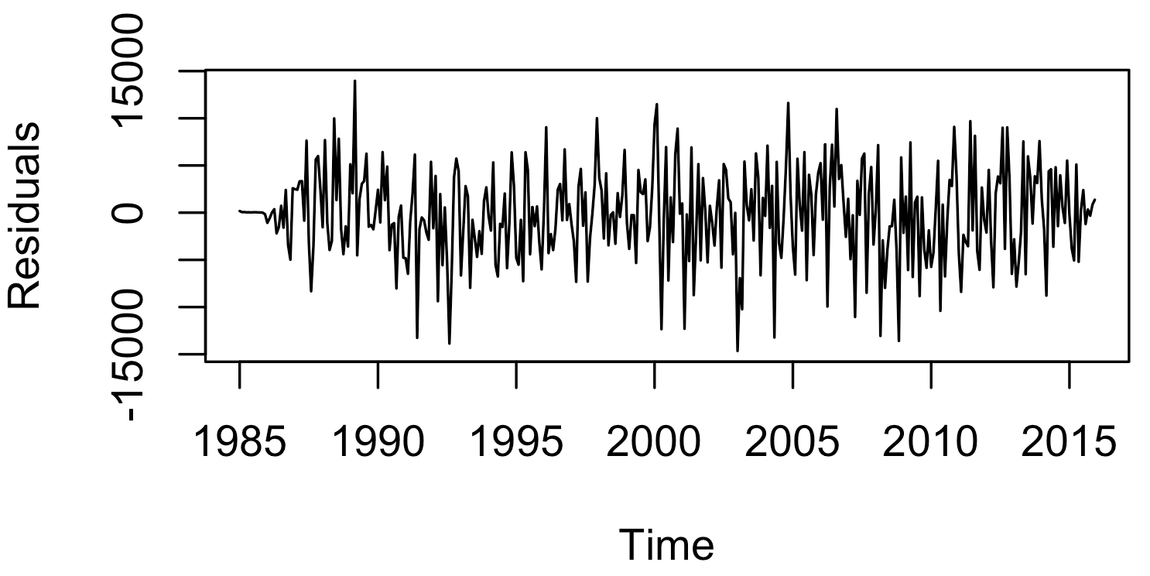
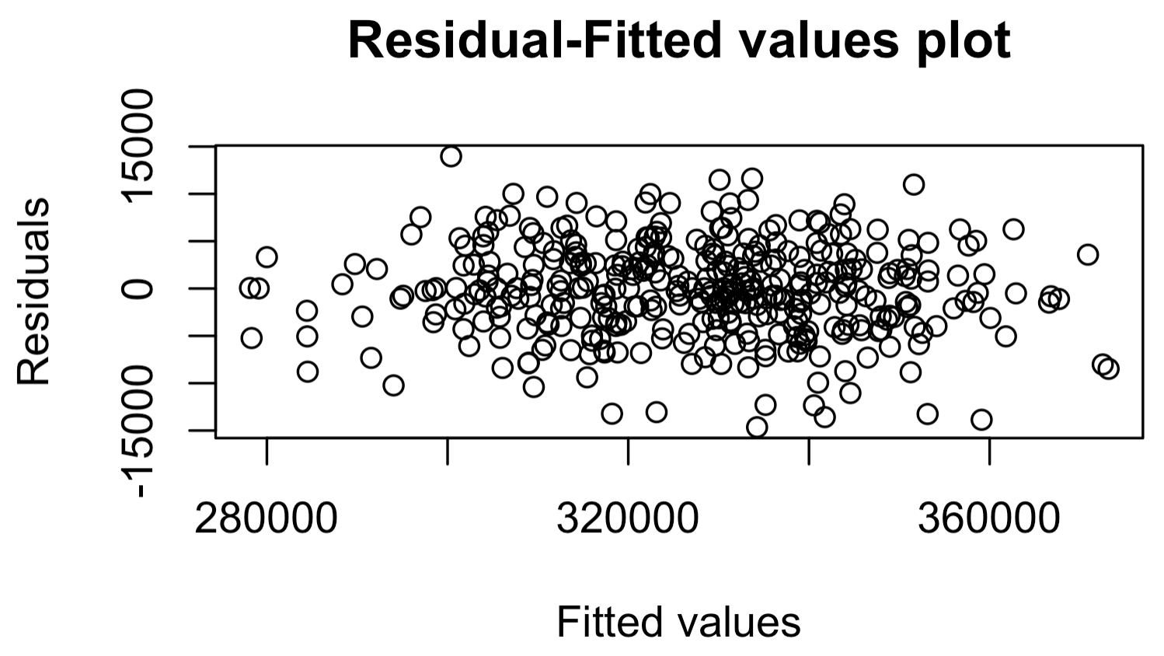


4. Forecasting models
The residuals for ARIMA model appear to be random, with no seasonality and trend detected.
ARIMA model: residual analysis

Slide 24


4. Forecasting models
Simple Linear Regression (SLR)
Predictor: Median annual household income from 1985 – 2015.
Regression result:

Slide 25

4. Forecasting models
SLR: Model validation
The validation process suggests that using the income can explain only 3% of the variations in birth rates.
More social indices such as healthcare, education, etc are needed for a multivariable regression model

Slide 26
4. Summary
Forecasting model evaluation
Model | MAPE (%) | Residual analysis
Naive | 4.30 | Cannot capture seasonality
Mean | 4.51 | Cannot capture most features
MA(3) | 2.49 | No seasonality/ trend detected
SES | 3.80 | Cannot capture seasonality
HW | 1.29 | No seasonality/ trend detected
Decomposition | 1.23 | No seasonality/ trend detected
ARIMA | 1.16 | No seasonality/ trend detected
SLR | Invalid
As per the evaluation, the ARIMA model by far provides the best forecast for the birth data, with a low MAPE and a valid residual analysis.
The ARIMA’s performance is closed ly followed the Decomposition and Holt-Winters. These can be great alternative options since they are less computationally demanding compared to ARIMA

Slide 27
4. Summary
I would pick the Holt-Winters since its MAPE differs from ARIMA and Decomposition very little, but it is easier to comprehend and demands less processing power. The alpha, beta, and gamma from HW are useful in understanding how the forecasts are generated.
A multivariable regression model is also a potential method. However, more social economic metrics are needed as input since human birth rates are more likely to be affected by multiple factors.

Slide 28
5. Discussion
THANK YOU

